Slide 1
Presentation name

Slide 2
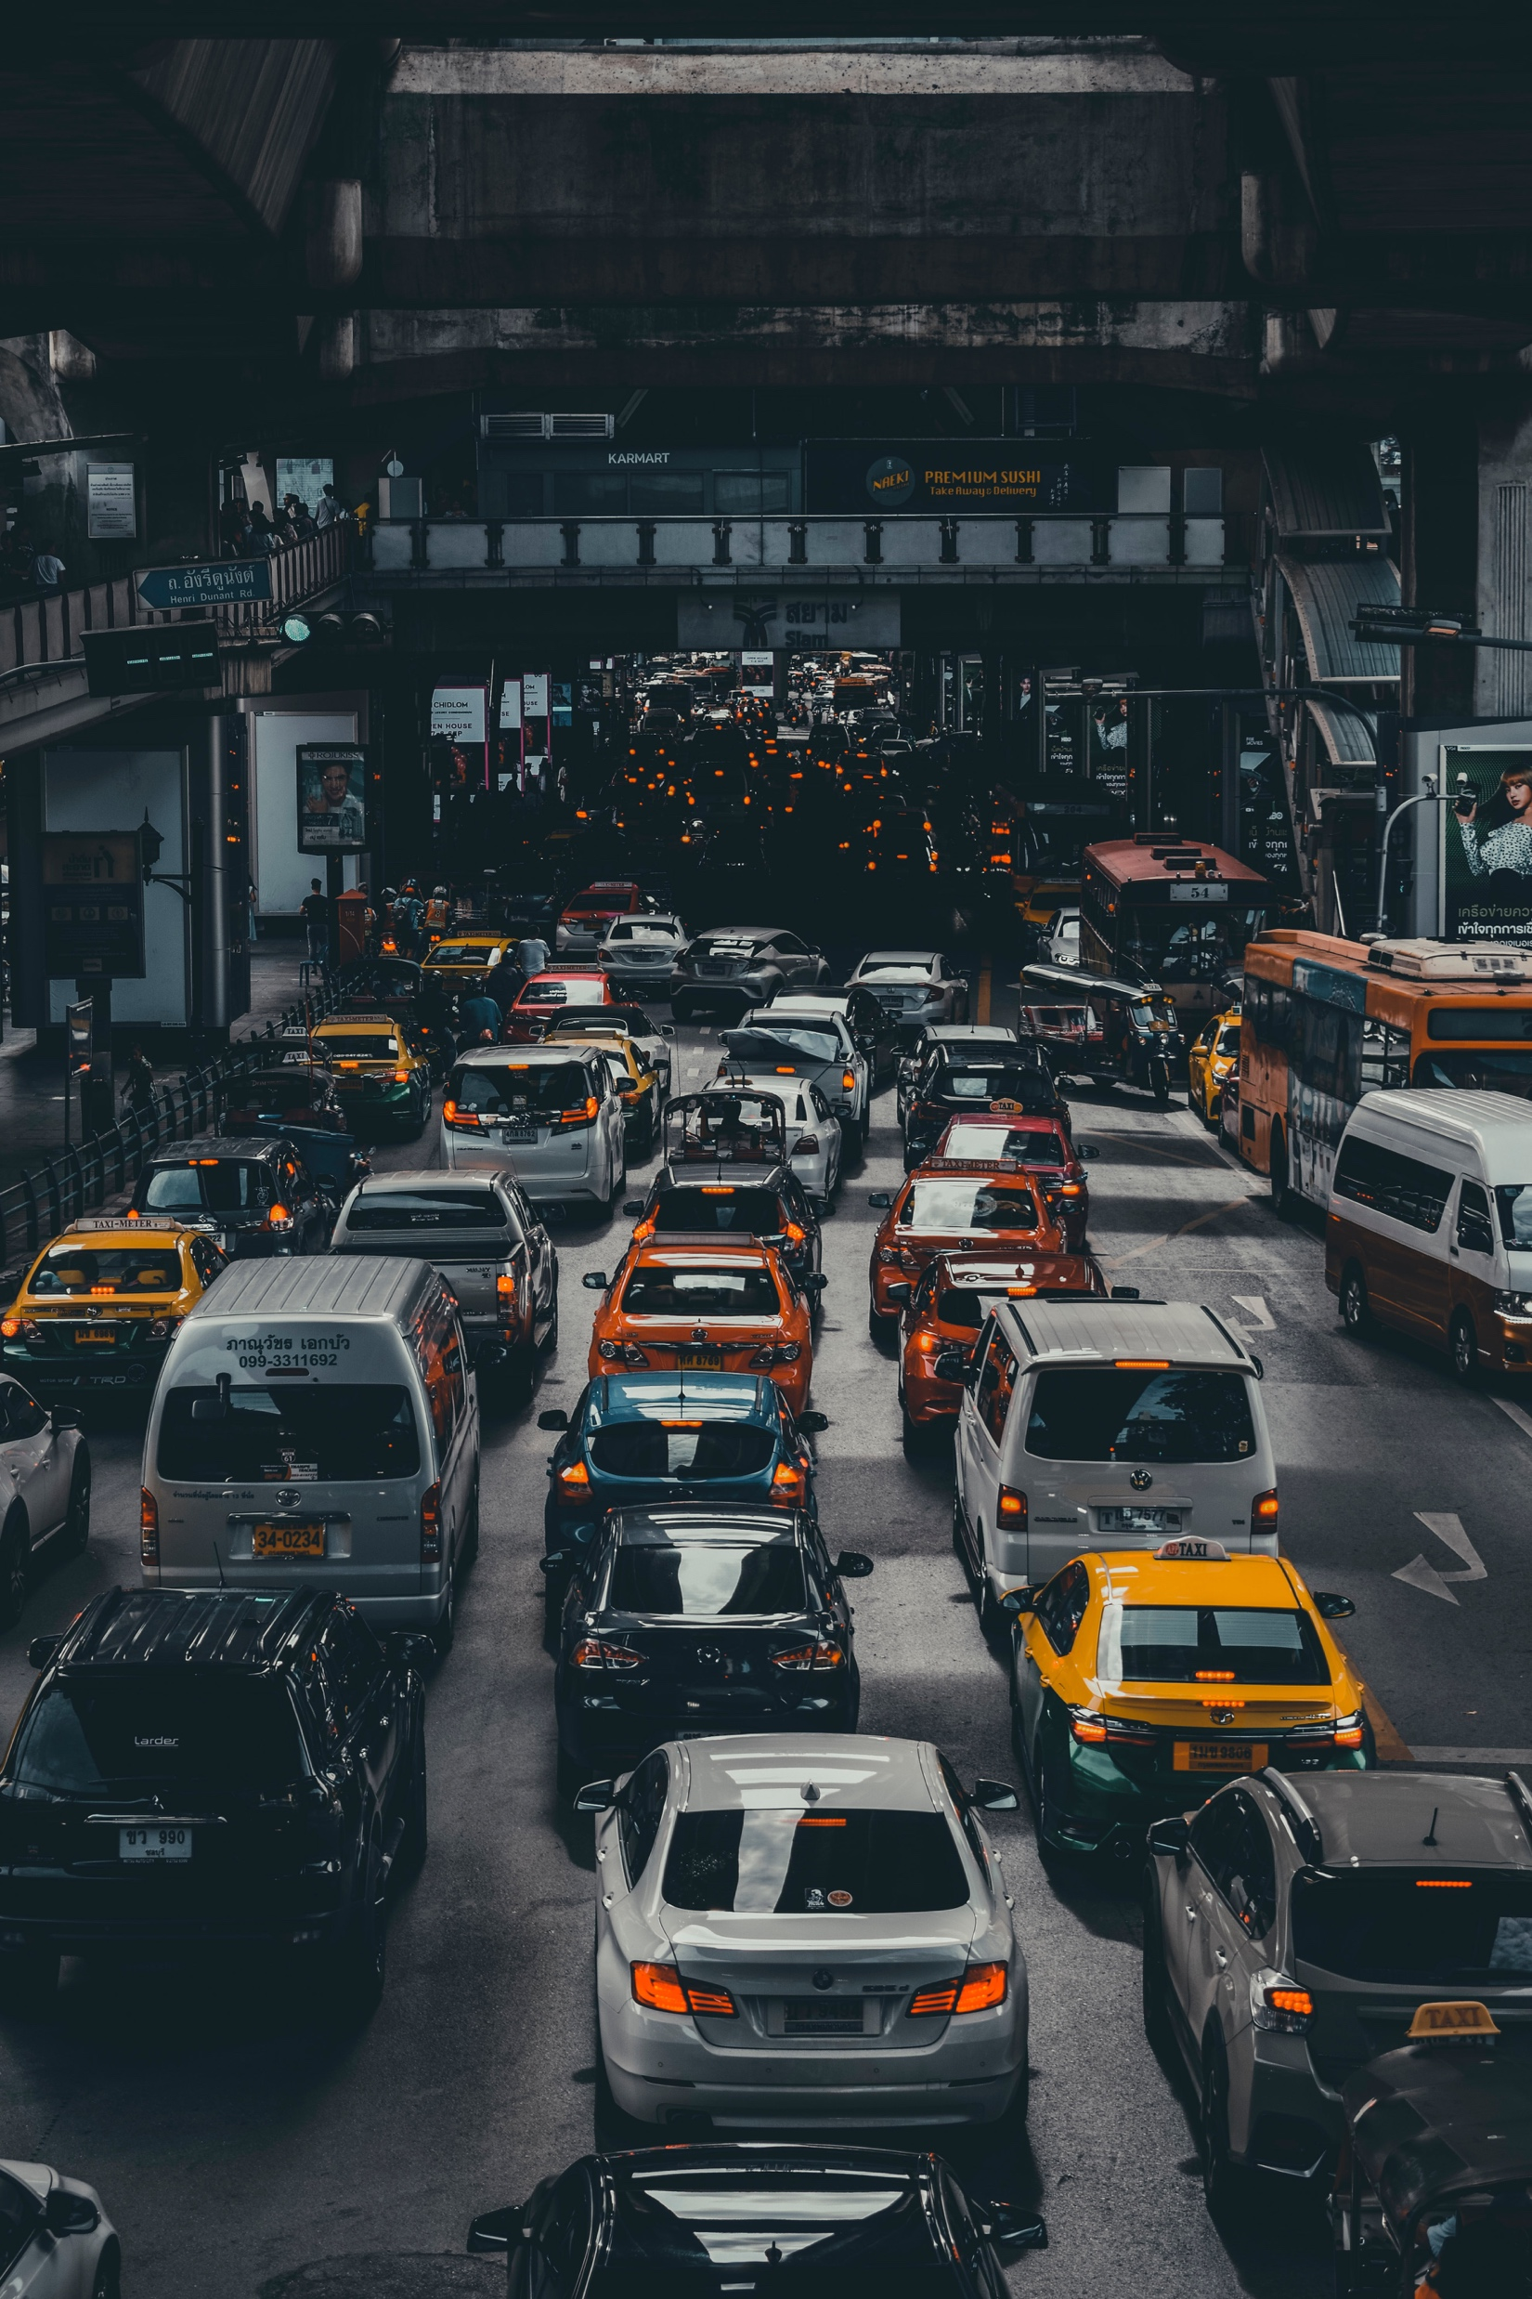
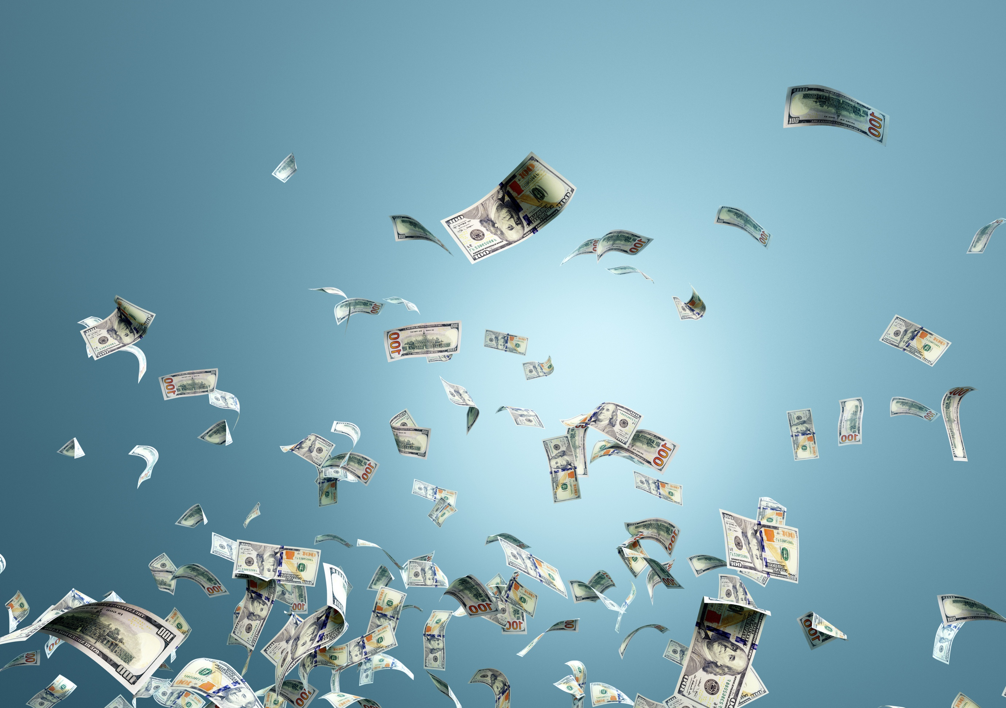
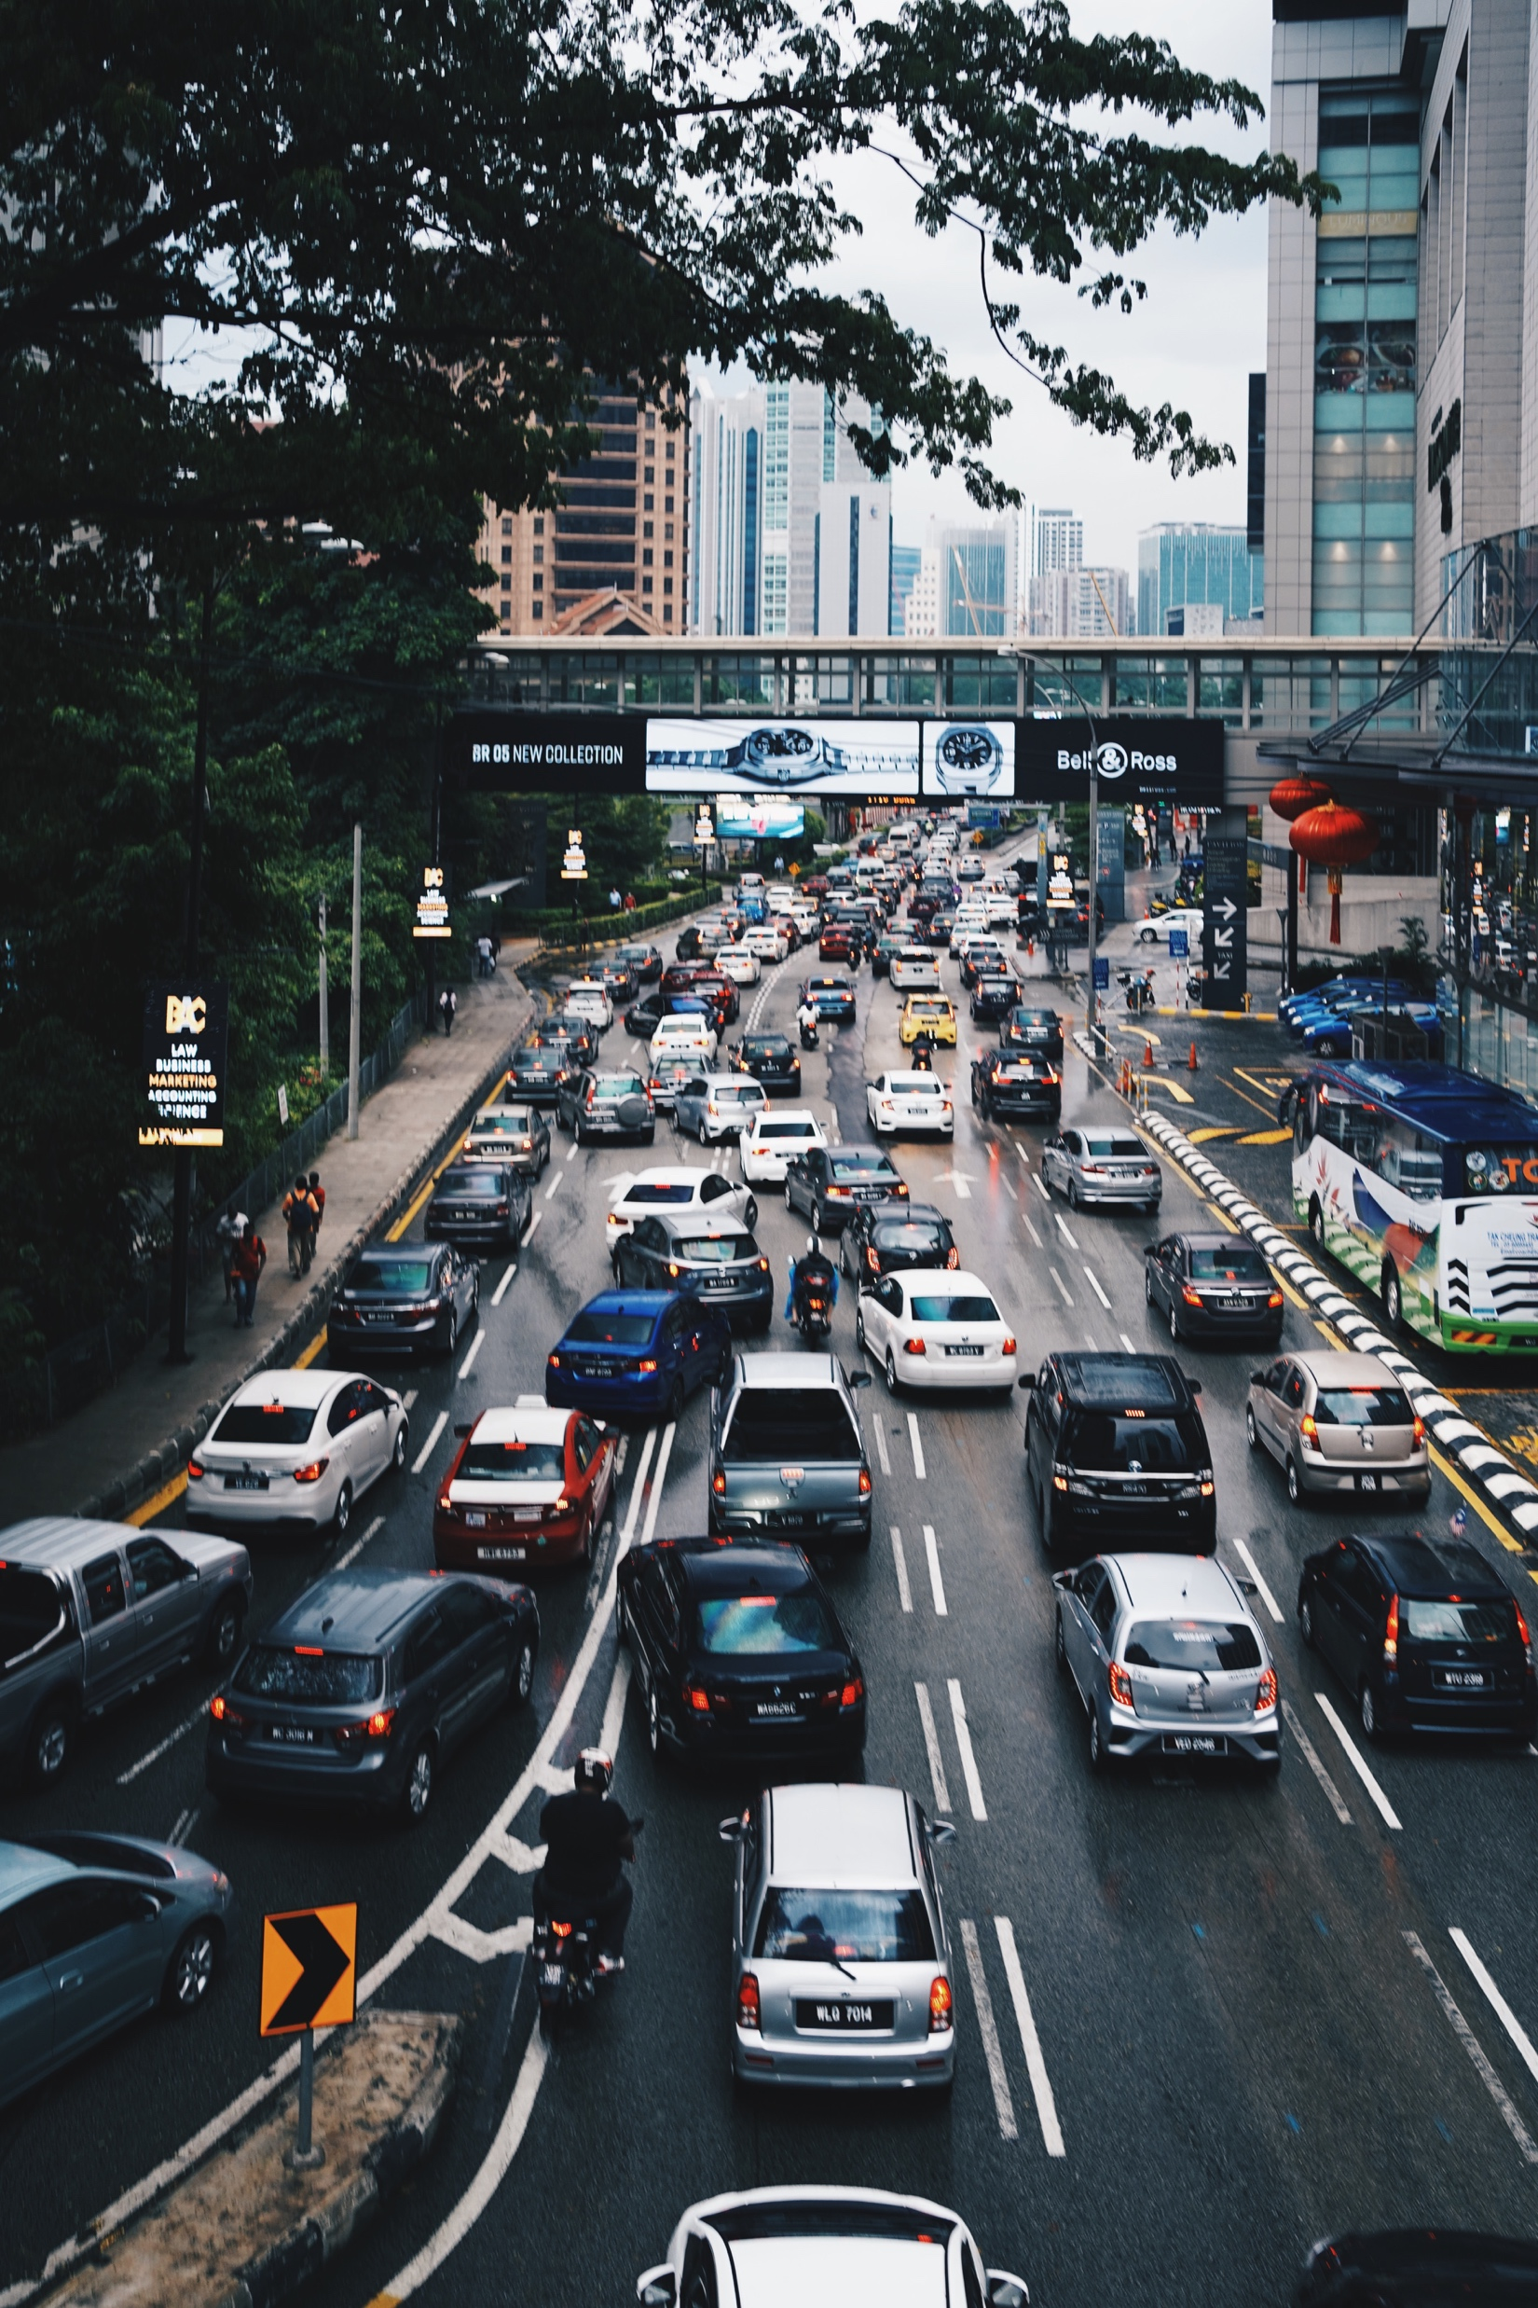
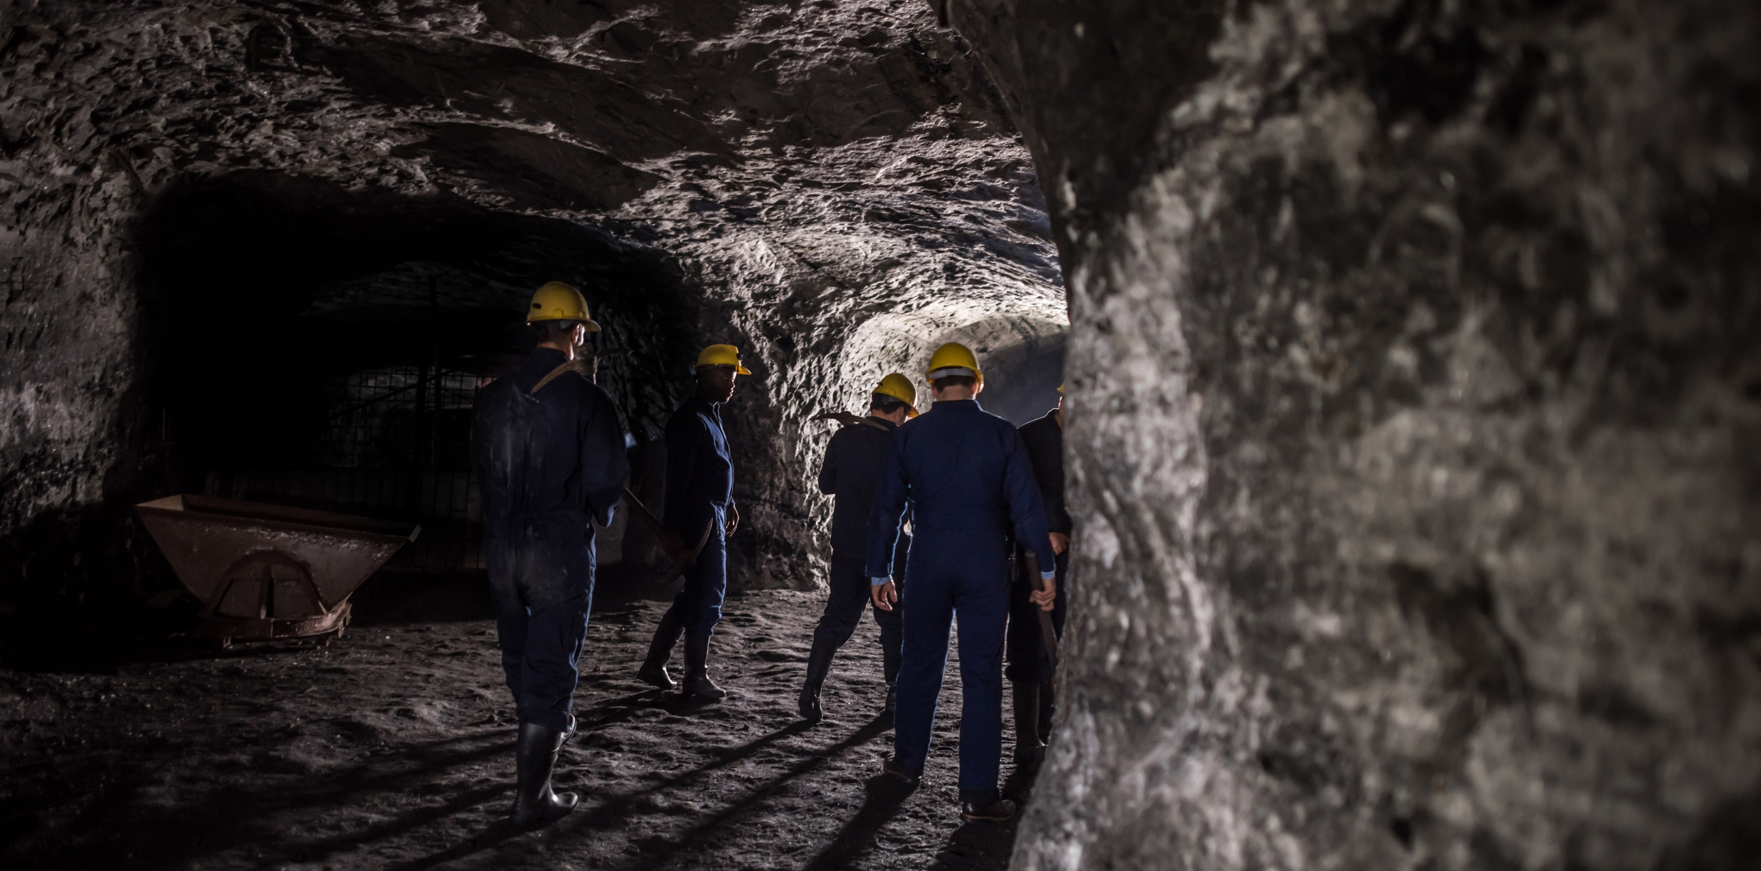
The alternative to traffic

Slide 3
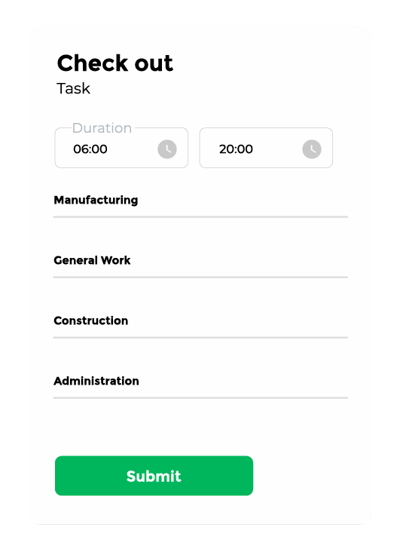
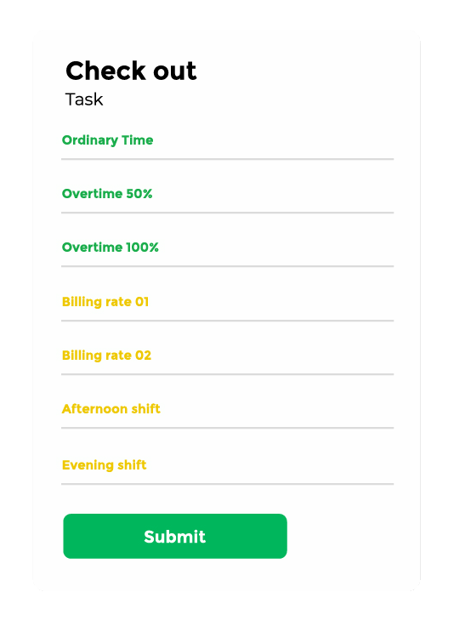
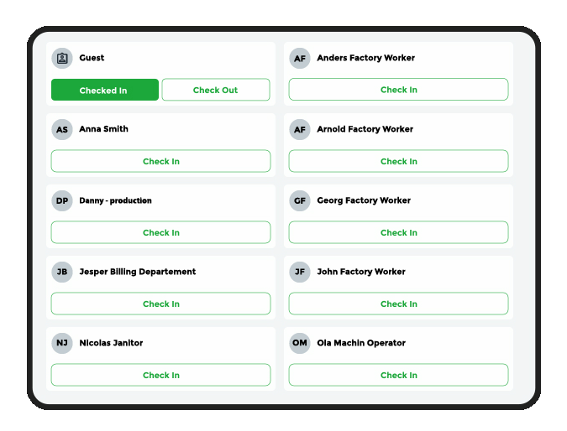
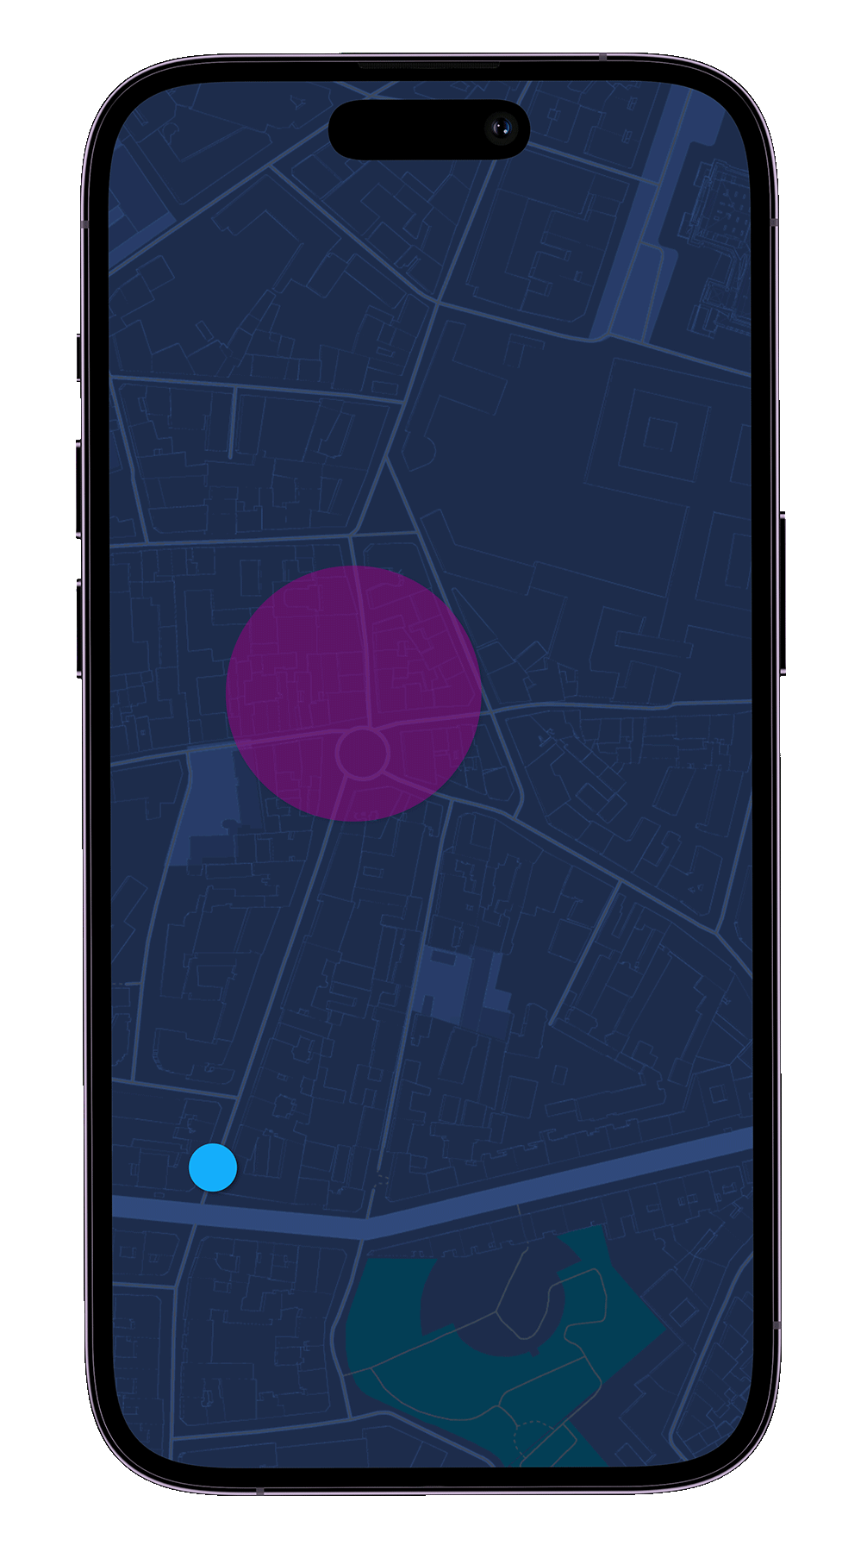
Connecting
Presentation name
Not hardware spesific
budgets
Projects
actuals
Apps, laptops, tablets – chose what´s practical
Not limited to any setup
Notes:
We often know what and how much- not when and who
Get your projects and tasks- plan them in any detail needed
Track progress based on actual work

Slide 4
Connecting
Presentation name
budgets
Projects
actuals
Not hardware spesific
Apps, laptops, tablets – chose what´s practical
Not limited to any setup
Notes:
We often know what and how much- not when and who
Get your projects and tasks- plan them in any detail needed
Track progress based on actual work

Slide 5
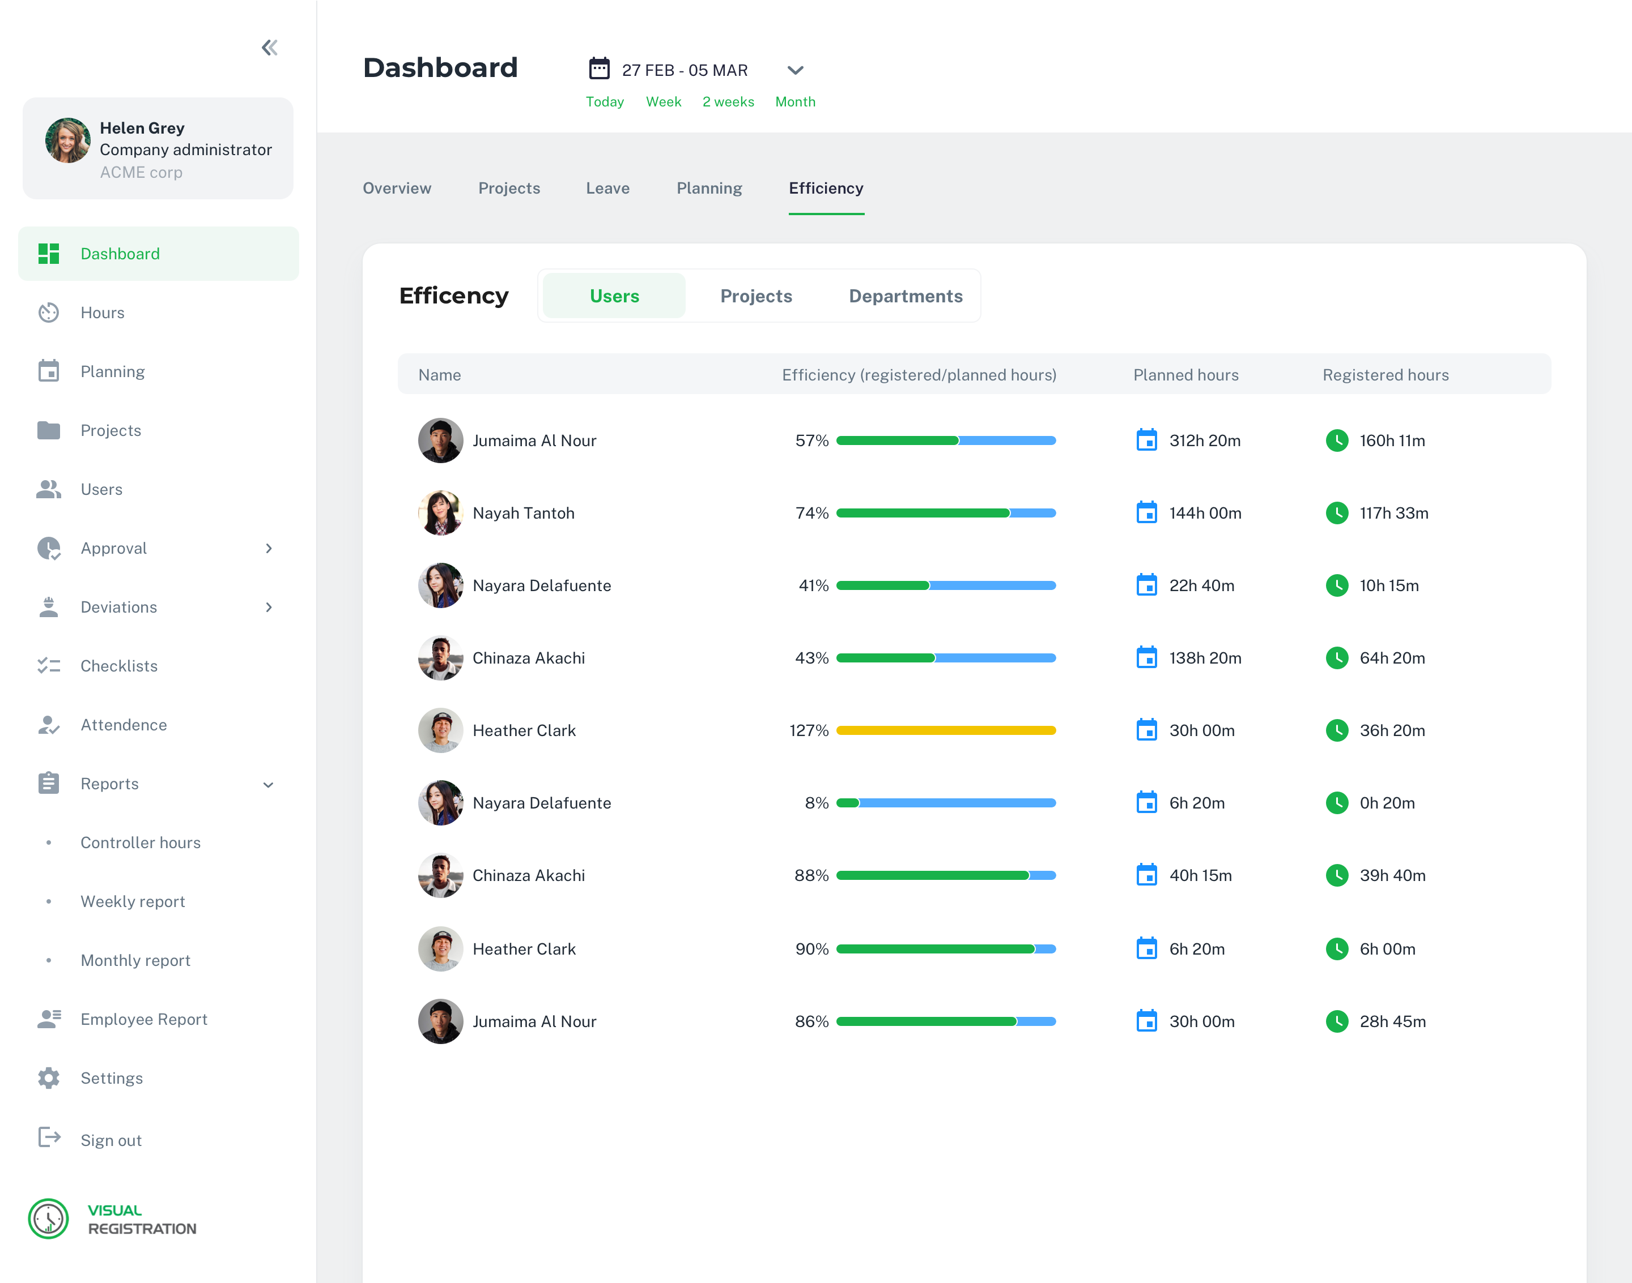
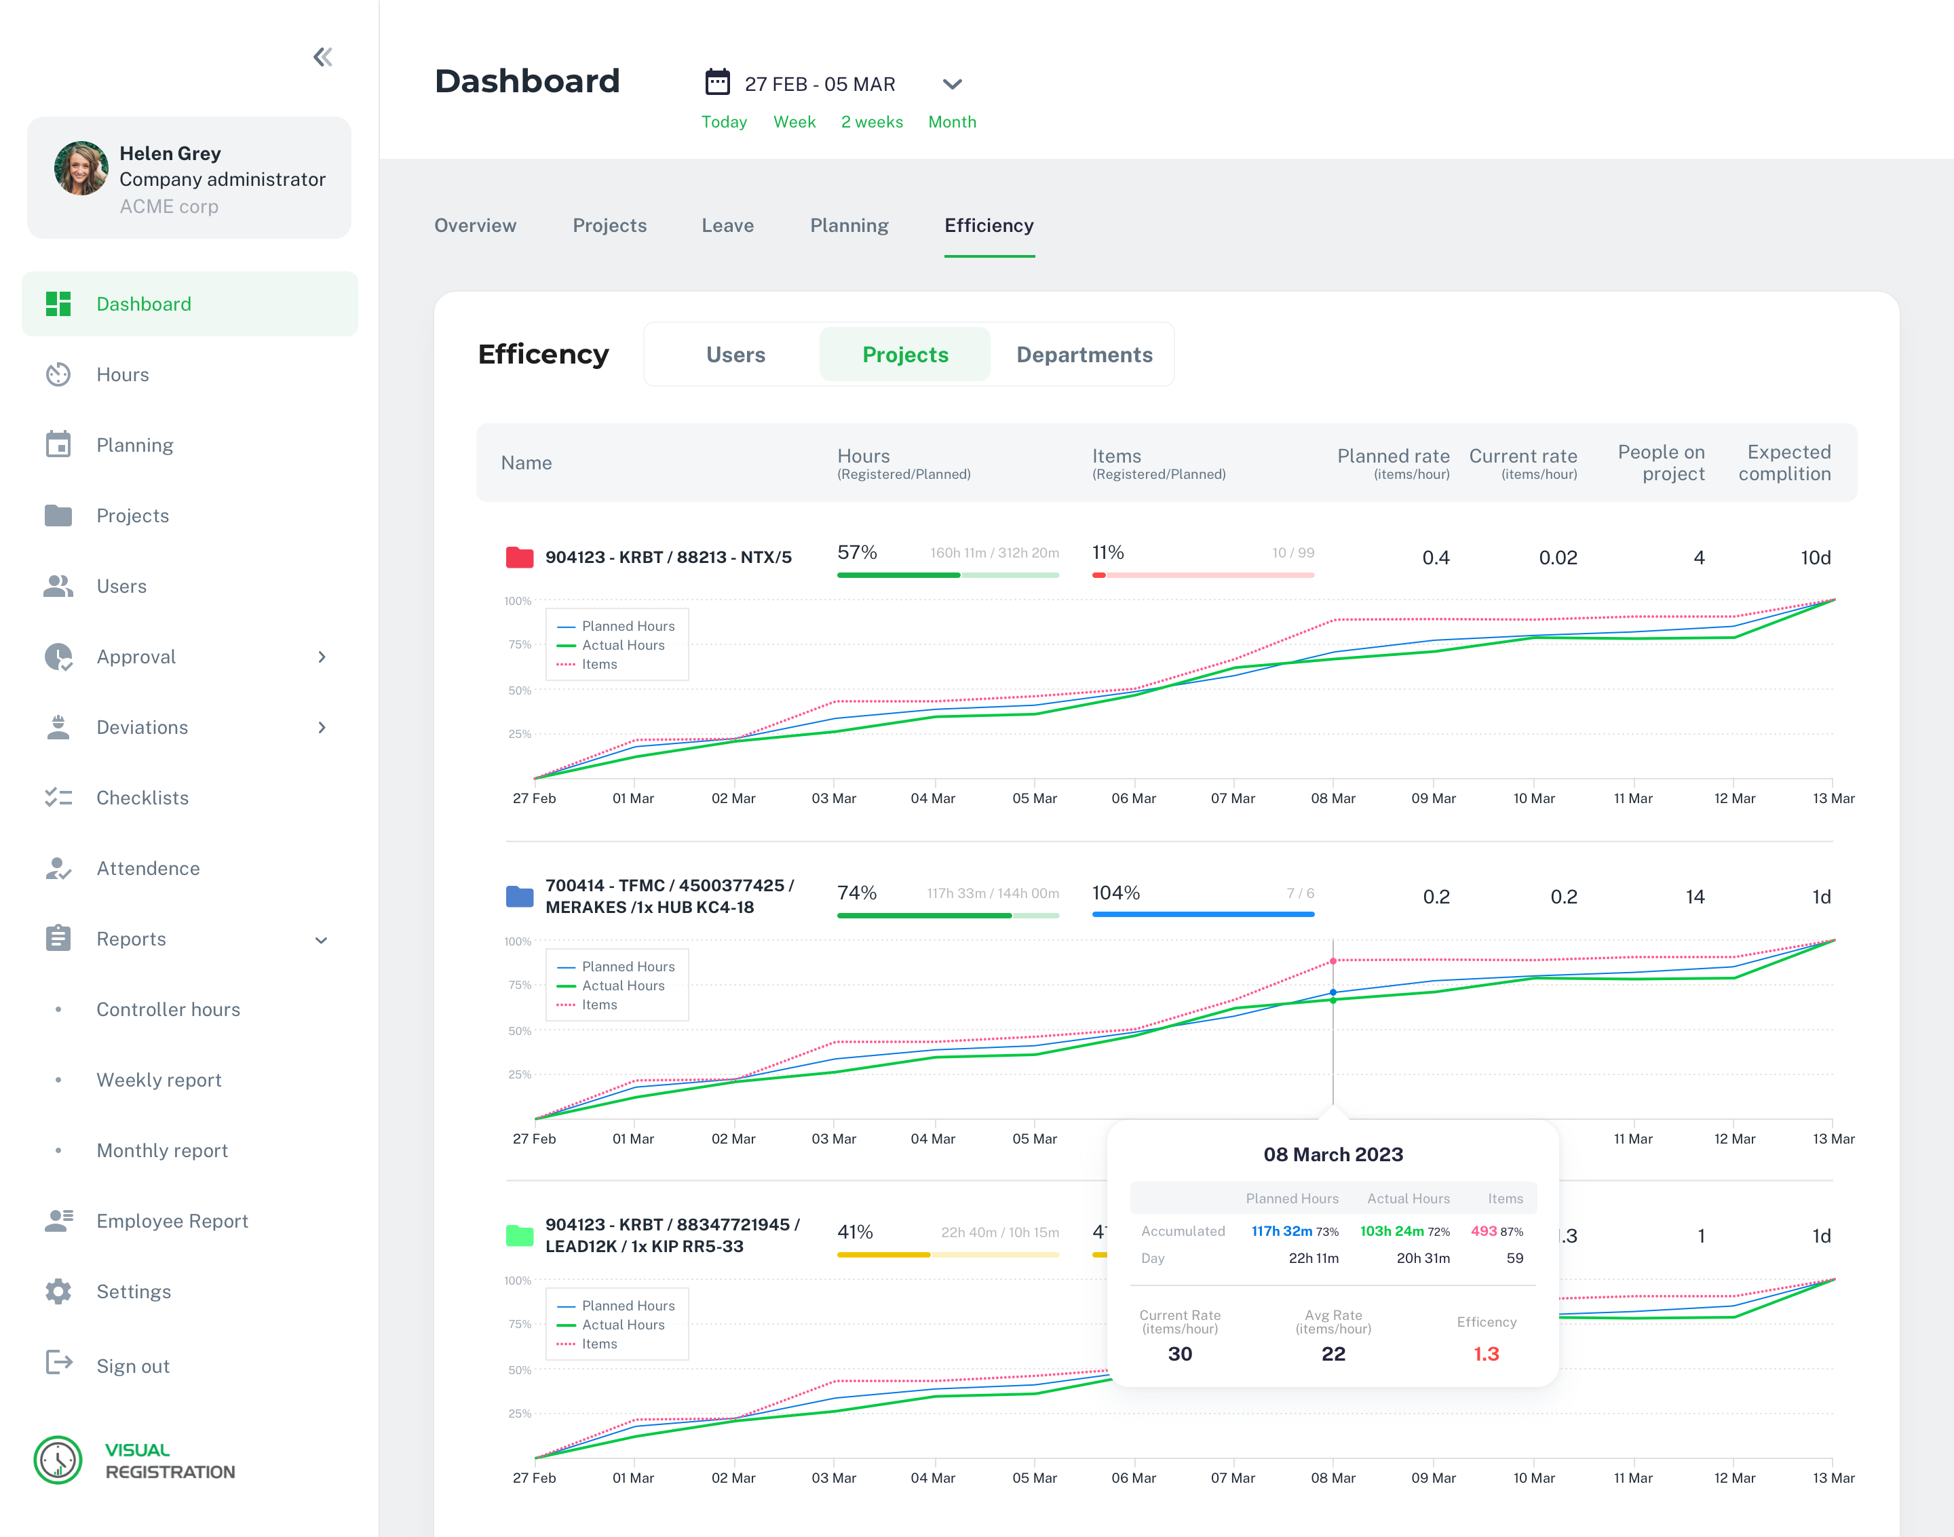
Connecting
Presentation name
budgets
Projects
actuals
Not hardware spesific
Apps, laptops, tablets – chose what´s practical
Not limited to any setup
Notes:
We often know what and how much- not when and who
Get your projects and tasks- plan them in any detail needed
Track progress based on actual work

